Slide 1
Creating Sessions
For Computer-Based Testing
Notes:
Welcome to the Creating Sessions for Computer-Based Testing training slides.

Slide 2
How to use this PowerPoint
Additional information is included in the Notes section of most slides.
Some slides in this PowerPoint have videos. When this occurs, it will be mentioned in the Notes section.
  When a video is available, please hover your cursor over the slide and select the Play button to view the video.
  For slides with videos, please remember to read the Notes section for additional information.

Slide 3
Topics
Glossary
Two Options to Create Sessions
Creating Sessions via SR/PNP Import
Creating Sessions via PearsonAccess^{next} User Interface
Resources
Notes:
In this training, we will provide an overview of the steps to create PearsonAccess^{next} Sessions for computer-based testing. These training slides are not applicable for paper-based testing.

Slide 4
Glossary
PearsonAccess^{next}: The online management system used to register students, order test materials, and manage activities for computer-based testing
Session: A group of students in PearsonAccess^{next} assigned the same subject and grade computer-based test who will take the test at the same time and in the same testing location.
ProctorCache: Pearson-supplied software that schools with low bandwidth may use in conjunction with TestNav to reduce bandwidth requirements. The software, which is optional, allows test coordinators or technology coordinators to precache test content to the local network before testing.
Precaching: the process of loading or “caching” test content locally to a designated precaching computer at a school.

Slide 5
Two Options to Create Sessions
 | When would you use this option?
Option 1: SR/PNP import (Sessions are automatically created) | when creating 5 or more PearsonAccess^{next} Sessions or when working with a large number of students
Option 2: PAN user interface | when creating 4 or fewer PearsonAccess^{next} Sessions or when working with a small number of students
Notes:
Schools may create PearsonAccess^{next} Sessions at any time prior to the start of testing, although it is recommended this be done two weeks prior to the start of testing. Schools should create separate PearsonAccess^{next} Sessions for students who will test at the same time and in the same location. You will want to choose a naming convention that's easy for your test administrators to find and manage. You could use the test administrator name, room number of the testing location, grade, subject, or a combination of these. A Session can only contain the students who are assigned the same test code (that is, those who are taking the same grade and subject test).
If your school needs five or more PearsonAccess^{next} Sessions to administer the test or has a large number of students, it is recommended to create Sessions via the SR/PNP import process, which will automatically create Sessions and add students to those Sessions. Multiple Sessions can be managed at the same time.
If you only have a few students to test and/or a few Sessions to create, it may be easier to create the Sessions in the PearsonAccess^{next­} user interface.
Important Note: If students will be using the Read Aloud or Human Signer accommodation, up to five students can be placed in a separate read aloud/human signer Session. The Session must be marked as a read aloud or human signer Session to ensure that the test administrator receives a proctor testing ticket and students are all assigned the same test form. We will explain the steps later in these slides.

Slide 6
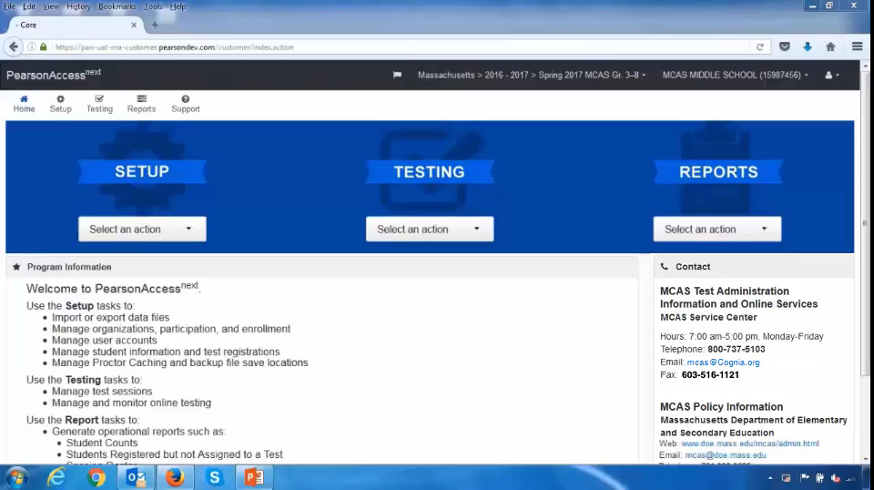
Creating Sessions via SR/PNP Import
Demonstration
Notes:
Please select the play button to view the video.
Step 1: If student records have already been uploaded into PearsonAccess^{next}, the first step is to export the file so that you can see all the student information.
First, make sure the correct test administration is selected in PearsonAccess^{next} (the test administration is located at the top drop-down section of the screen). Then, go to Setup and Import/Export Data. Click Select Tasks and Import/Export Data, and click Start. Under Type, select Student Registration Export. Click Process, and then click refresh until the file is ready to download.
Step 2: When the file has downloaded, open it and add the appropriate Session names for each student in column M. If you are familiar with the VLOOKUP function in Microsoft Excel, you may want to create a VLOOKUP table to automate assigning students to Sessions, which could be helpful when working with a large student population in five or more Sessions.
When you have finished adding the Session name, make sure that all of the students were assigned to Sessions correctly, and then save the file as a .CSV.
Remember, students who have a human read aloud or human signer must have this designated in the SR/PNP and will need to be placed in a separate Human Read Aloud/Human Signer Session of up to five students. Students may initially be placed in a Human Read Aloud/Human Signer Session using the file import procedure, but the Session must be finalized in the user interface using the Create/Edit Sessions task.
Please note that creating Sessions via SR/PNP import is a "one-time" procedure. If you discover errors in Session names after the SR/PNP file import, any changes must be made using the PearsonAccess^{next} user interface. If you discover several errors in Session names, contact the MCAS Service Center for assistance.
Step 3: Now that column M is populated with Session names, it’s time to import the file. Select Import/Export Data and click Start. Under Type, select Student Registration Import. Refresh until the file has finished importing. If you find any errors in importing the file, refer to the Guide to the SR/PNP Process, which we’ll discuss on the Resources slide later on in this module.
Step 4: Confirm that your Sessions have been created by going to Testing and Sessions.
Step 5: If you need to change a Session name or indicate the Session as Human Read Aloud or Human Signer, you will now need to do this in the PearsonAccess^{next} user interface. Check the box next to the Session name and go to Select Tasks and Create/Edit Sessions. To indicate the Session as Human Read Aloud or Human Signer, check the box next to Proctor Reads Aloud and then select either Human Read-Aloud or Human Signer from the Form Group Type dropdown. Click Save when finished and Exit Tasks.

Slide 7
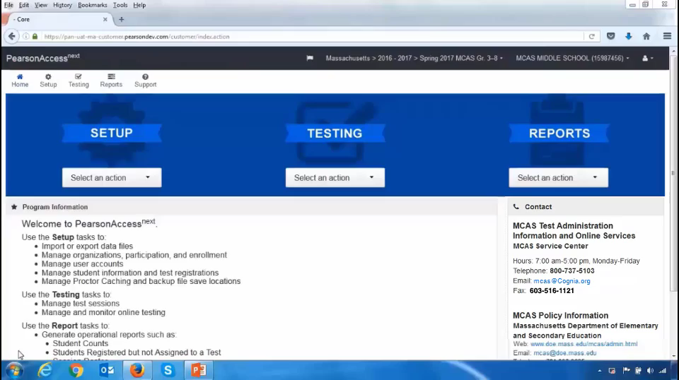
Creating Sessions via PearsonAccess^{next} User Interface
Demonstration
Notes:
Please select the play button to view the video.
Step 1: To create a Session in the user interface, go to Testing, and then Sessions. Go to Select Tasks, and then select Create/Edit Sessions. Fill out all the details on this page and select the Precaching Computer, if your organization is using ProctorCache. If you are unsure which precaching computer to select, you should contact your technology coordinator for assistance. The Create/Edit Sessions screen is also where you will indicate a Human Read Aloud or Human Signer Session.
Step 2: When you get to the bottom of the screen, you will see the option to Add Students to Session. Simply search for a student’s name and click on it to add the student to the Session. Click Save and then Exit Tasks.
Step 3: If you need to change the name of a PearsonAccess^{next} Session, indicate a Session as Human Read Aloud or Human Signer, or add a student to an existing Session, you can easily do this by using the Edit Sessions task. On the Sessions screen, search for and check the box next to the Session name, and select the Create/Edit Sessions task. Click Save when finished, and then click Exit Tasks.
To view the Sessions you created and students assigned to those Sessions, go to Reports then Operational Reports. Then select the Online Testing report category and view the Session List and the Session Roster reports. You may then share these rosters with your test administration teams.

Slide 8
Resources
PearsonAccess^{next} User Guide (URL:https://support.assessment.pearson.com/x/BYDy)
Guide to the Student Registration/Personal Needs Profile
(URL: http://mcas.pearsonsupport.com/manuals/)
PearsonAccess^{next} User Role Matrix
(URL: http://mcas.pearsonsupport.com/manuals/)
Notes:
Here are the resources to help you with the process when you are ready to create Sessions in PearsonAccess Next.

Slide 9
Thank You
Thank you.
Notes:
This concludes the Creating Sessions training slides. Thank you.

